Slide 1

Is it possible to predict the popularity of a book by its characteristics?
FINAL PROJECT
Assigned by Yaniv Levizada
Using Data Scraping and Machine Learning methods

Slide 2

Elaboration on research process
1. Data Acquisition – Crawling the website we want to fetch the information from, and gathering it all together.
2. EDA – Filtering and cleaning the data, analyzing it and visualizing insights based on the data we acquired.
3. Machine Learning – Using ML techniques to help us predict popularity of a book, and benchmarking the performance of the models.
4. Conclusions – Stating conclusions from the models regarding our research question.

Slide 3
Data sources
Data acquisition using scraping:
GoodReads
Note: Some websites want to prevent us from flooding their sites with requests or prevent automation, therefore they use pop-ups or any other techniques to prevent us doing so.
Fun Fact: Web scraping is about extracting the data from one or more websites, While crawling is about exploring URLs on the web.
Data Acquisition
EDA
Machine Learning
Conclusions

Slide 4
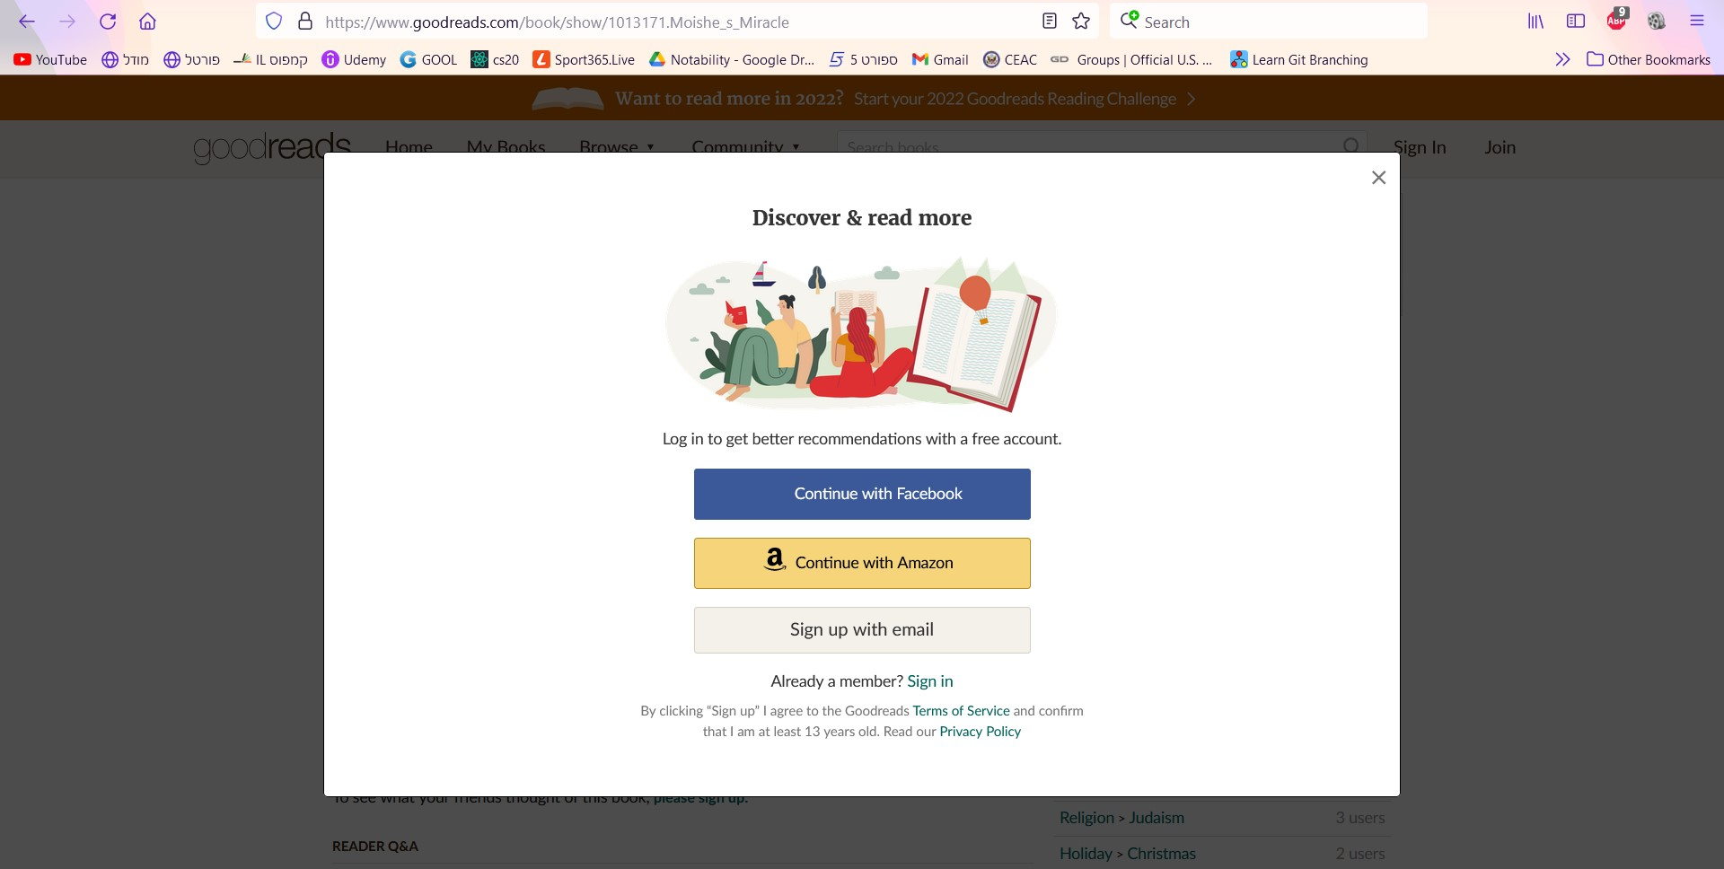

Slide 5
Packages used during the research:
Pandas - analysis and manipulation tool BeautifulSoup - parsing HTML and XML documents requests - HTTP library matplotlib – Visualization of data (scatterplots, histograms..) Seaborn – Visualization of data, a library that’s based on matplotlib (heatmap) sklearn – machine learning library used in Python

Slide 6
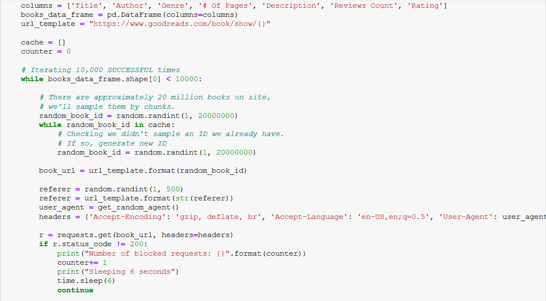
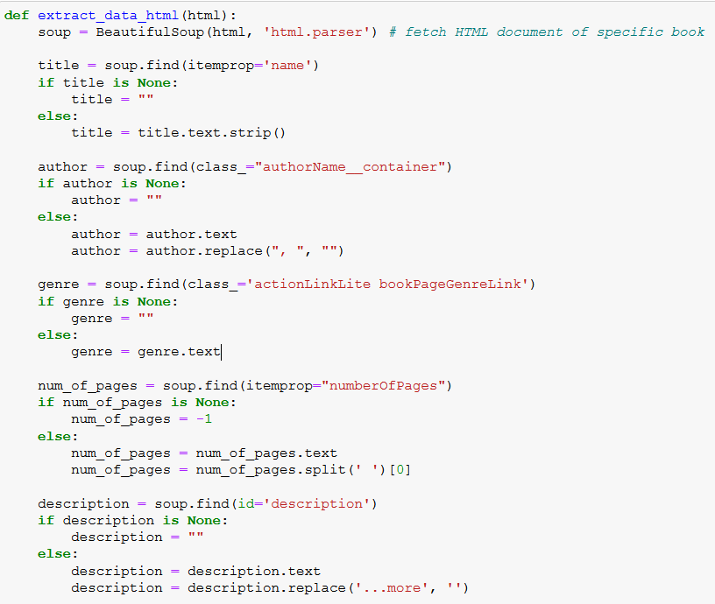
A little bit of code…

Slide 7
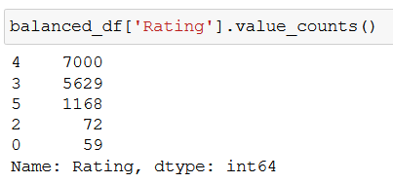
EDA (exploratory data analysis)
Filtering unwanted values such as nulls, checking for correlations in the data, balancing the data (there were too many book labels rated with 4 stars)
Visualizing the data to gain insights and understand the structure of our data set.
There were no duplicates in the data set as we iterated by chunks of a few millions on each iteration.
Handling outliers – Cleaning outliers that might mislead our model (In this case, # of pages and # of reviews had some outliers)
Conclusions
Machine Learning
EDA
Data Acquisition

Slide 8
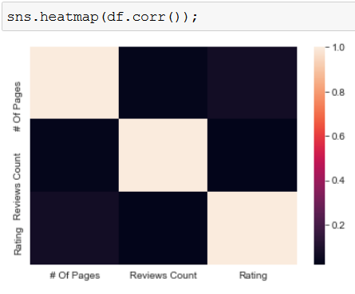
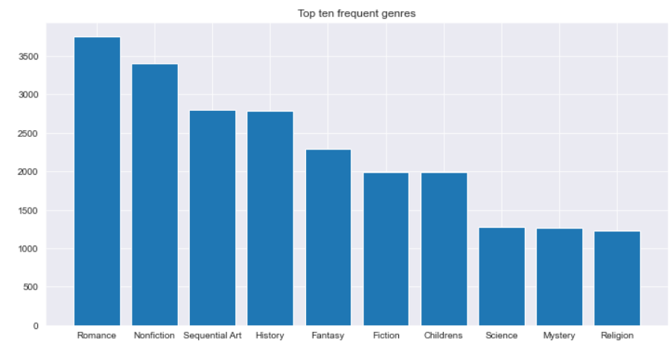
Let’s observe some insights:
There’s an insignificant correlation between the features in our data. (Which is a good thing)
An histogram that describes the top 10 most frequent genres in the data set. Romance is most frequent section.
Conclusions
Machine Learning
EDA
Data Acquisition

Slide 9
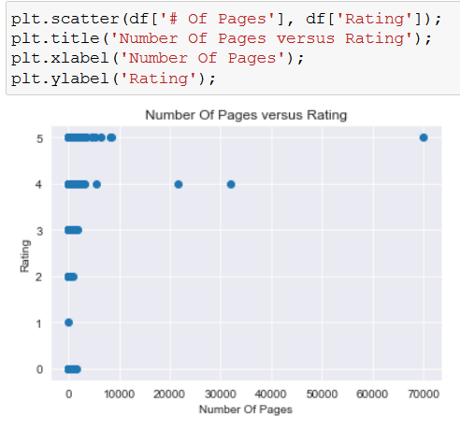
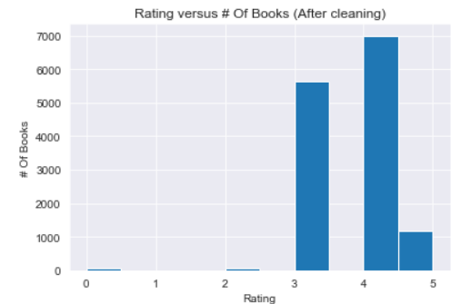
Higher number of pages doesn't reflect a better book at all, as there is no apparent correlation.
As seen on the plot, many reviewers rate the books on the website with 3-5, mostly.
Conclusions
Machine Learning
EDA
Data Acquisition

Slide 10
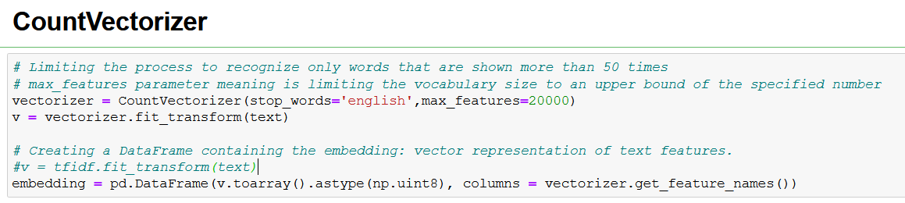
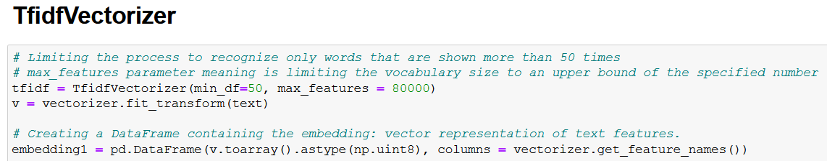
Machine Learning
During this phase, in order to handle “Description” feature, I used two different algorithms: CountVectorizer, TfidfVectorizer.
Their main purpose is to turn the paragraphs into vectors that the model can use.
In order to help the learning process, I used LabelEncoder (transforms the data into numbers) and StandardScaler (normalizes the data between 0-1)
The data fetched from Goodreads isn’t stable when it comes to the Rating label. So in order to try and improve accuracy percentage, I used more than one model.
Conclusions
Machine Learning
EDA
Data Acquisition

Slide 11
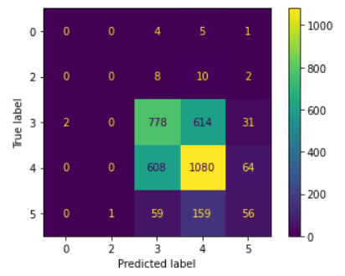
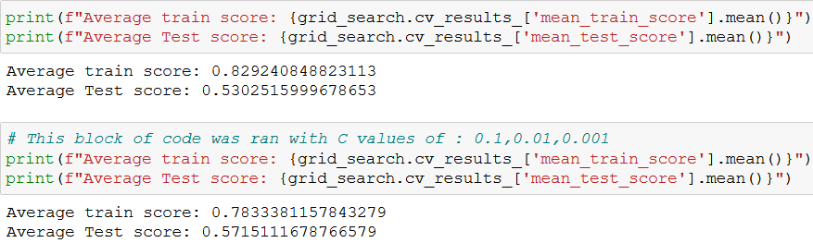
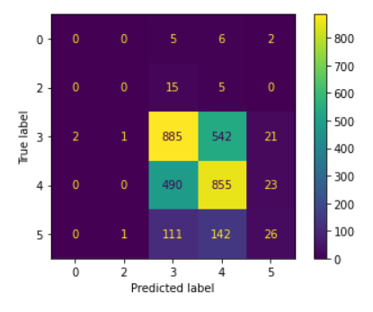
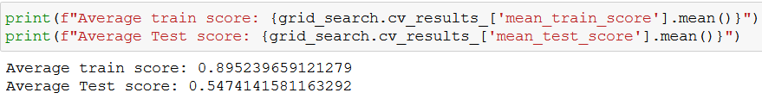
CountVectorizer: Logistic Regression and Random Forest (Which is basically a bunch of Decision Trees)
Logistic Regression
Random
Forest
Conclusions
Machine Learning
EDA
Data Acquisition

Slide 12
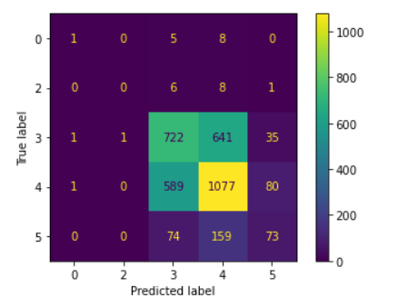
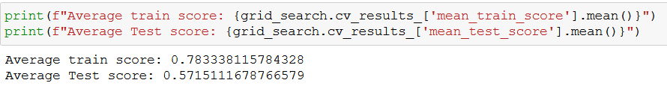
TfidfVectorizer I tried to test the performance with Logistic Regression
Conclusions
Machine Learning
EDA
Data Acquisition

Slide 13
Conclusions
As can be seen, I tried to improve performance in various ways, but the core problem relies on the data - may of the users on Goodreads rate books mainly with 3 to 5 stars, which creates instability with the data.
As can be observed, CountVectorizer worked a bit better with our data comparing to TfidfVectorizer, but both algorithms converge to about 53-57 % of precision.
Conclusions
Machine Learning
EDA
Data Acquisition

Slide 14
Thank you for listening!
https://github.com/yaniv208/DataScienceProject

